Slide 1
Clinical Psychology
Alan J Banaszynski, DC, MSW
Research and Powerpoint presentation assistance provided by:
Dr. Christine Schutz Ph.D.

Slide 2
WHO CARES???
MANDATED REPORTER
  DEFINITION
  an individual who holds a professional position (as of social worker, physician, teacher, chiropractor, clergy, or counselor) that requires him or her to report to the appropriate state agency cases of child abuse that he or she has reasonable cause to suspect.
  CATEGORIES
    Children
    Elderly
    Domestic Violence
    Mental Illness PREVALENCE- At any given time 1 out of 6: cross-section

Slide 3
Prevalence(%) of Psychiatric Disorders in the USA
Disorder Lifetime 12mos
Psychiatric 48.0 29.5
Affective 19.3 11.3
Major Depression 16.2 6.6
Anxiety Disorder 24.9 17.2
Substance Abuse 26.6 11.3
Goldberg, R.J. The Care of the Psychiatric Patient 3rd ed. 2007

Slide 4
Child Abuse Federal Guidelines
The Child Abuse Prevention and Treatment Act (CAPTA)—Federal Guidelines
Under the Federal Child Abuse Prevention and Treatment Act (CAPTA) passed in 1974, all 50 states have passed laws mandating the reporting of child abuse and neglect.
CAPTA provides a foundation for the States by identifying a minimum set of acts or behaviors that characterize physical abuse, neglect and sexual abuse.
These laws vary from state to state.
Each state is responsible for:
  providing its own definition of child abuse and neglect.
  describing the circumstances and conditions that obligate mandated reporters to report known or suspected child abuse.
  providing definitions for juvenile/family courts when to take custody of the child.
  specifying the forms of maltreatment that are criminally punishable.
Mandated Reporting Laws change from time to time. You should consult your local Child Protective Services for the most current statute, if you have any questions or concerns about your responsibilities. See below for links to resources for information.

Slide 5
State Law examples
Missouri law, at 210.110.(1) RSMo., defines "abuse" as:
". . . any physical injury, sexual abuse, or emotional abuse inflicted on a child other than by accidental means by those responsible for the child's care, custody, and control, except that discipline including spanking, administered in a reasonable manner, shall not be construed to be abuse.
Missouri law, at 210.110.(12) RSMo., defines "neglect" as:
". . . failure to provide, by those responsible for the care, custody, and control of the child, the proper or necessary support, education as required by law, nutrition or medical, surgical, or any other care necessary for the child's well-being."
A child is any person, regardless of physical or mental condition, under eighteen years of age. Section 210.110.(4).
MANDATED REPORTERS (210.115 RSMo.)
The following individuals must report child abuse: (1) Teachers, principals, and other school officials; (2) Health care professionals (physicians, medical examiners, coroners, dentists, chiropractors, optometrists, podiatrists, residents, interns, nurses, hospital or clinic personnel); (3) Mental health professionals; (4) Social workers; (5) Day care/child-care workers; (6) Law enforcement officials (police officers, juvenile officers, probation/parole officers, jail or detention facility personnel) (8) Ministers; (10) Other persons with responsibility for the care of children.

Slide 6
Failure To Report
  MISSOURI Class A misdemeanor.
  Michigan Civil and Criminal Liability
Mandated reporters, who fail to file a report of suspected child abuse or neglect, will be subject to both civil and criminal liability. In a civil action, the mandated reporter may be held liable for all damages that any person suffers due to the mandated reporter's failure to file a report. In a criminal action, the mandated reporter may be found guilty of a misdemeanor punishable by imprisonment for up to 93 days and a fine of $500.

Slide 7
Signs or Symptoms
Physical Abuse Unexplained recurrent injuries or burns
Improbable excuses or refusal to explain injuries
Wearing clothes to cover injuries, even in hot weather
Refusal to undress for gym
Bald patches
Chronic running away
Fear of medical help or examination
Self-destructive tendencies
Aggression towards others
Fear of physical contact—shrinking back if touched
Admitting that they are punished, but the punishment is excessive (such as a child being beaten every night to "make him/her study")
Fear of suspected abuser being contacted

Slide 8
Signs or Symptoms (cont.)
Sexual Abuse
-Being overly affectionate or knowledgeable in a sexual way inappropriate to the child's age
-Medical problems such as chronic itching, pain in the genitals, venereal diseases
-Other extreme reactions, such as depression, self-mutilation, suicide attempts, running away, overdoses, anorexia
-Personality changes such as becoming insecure or clinging
-Regressing to younger behavior patterns such as thumb sucking or bringing out discarded cuddly toys
-Sudden loss of appetite or compulsive eating
-Being isolated or withdrawn
-Inability to concentrate
-Lack of trust or fear someone they know well, such as not wanting to be alone with a babysitter
-Starting to wet again, day or night/nightmares
-Become worried about clothing being removed
-Suddenly drawing sexually explicit pictures
-Trying to be "ultra-good" or perfect; overreacting to criticism

Slide 9
Child Abuse vs Corporal Punishment
Corporal punishment is the deliberate infliction of pain intended to punish a person or change his/her behavior.
How do you discern between the two as a professional?
Does the state I intend to practice in allow some form of corporal punishment?

Slide 10
Where the states stand on corporal punishment: Legal=23
Alabama--Legal
Alaska--Illegal
Arizona--Legal
Arkansas--Legal
California--Illegal
Colorado--Legal
Connecticut--Illegal
Delaware--Illegal
District of Columbia--N/A
Florida--Legal
Georgia--Legal
Hawaii--Illegal
Idaho--Legal
Illinois--Illegal
Indiana--Legal
Iowa--Illegal
Kansas--Legal
Kentucky--Legal
Louisiana--Legal
Maine--Illegal
Maryland--Illegal
Massachusetts--Illegal
Michigan--Illegal
Minnesota--Illegal
Mississippi--Legal
Missouri--Legal Montana--Illegal
Nebraska--Illegal
Nevada--Illegal
New Hampshire--Illegal
New Jersey--Illegal
New Mexico--Legal
New York--Illegal
North Carolina--Legal
North Dakota--Illegal
Ohio--Legal
Oklahoma--Legal
Oregon--Illegal
Pennsylvania--Legal
Rhode Island--Restricted*
South Carolina--Legal
South Dakota--Illegal
Tennessee--Legal
Texas--Legal
Utah--Illegal
Vermont--Illegal
Virginia--Illegal
Washington--Illegal
West Virginia--Illegal
Wisconsin--Illegal
Wyoming--Legal

Slide 11
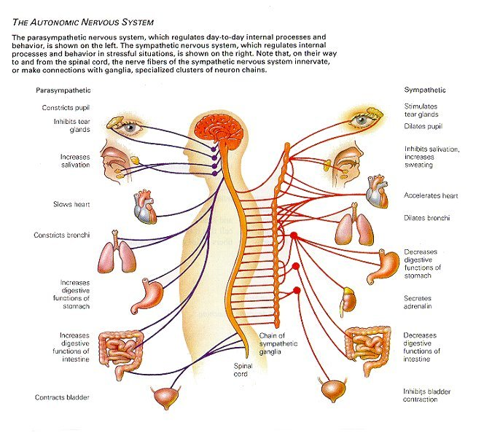

Slide 12
Defense Mechanisms
Denial
Repression
Suppression
Displacement
Sublimation
Projection
Intellectualization
Rationalization
Regression
Reaction-formation

Slide 13
Classic Developmental Theories
Behavioral Theories
Cognitive Theories
Developmental Theories
Humanist Theories

Slide 14
Psychoanalytic View of Development
Age | Freud | Erikson
1st yr | Oral stage | Infancy: Trust vs. Mistrust
1-3 | Anal Stage | Early Childhood: Autonomy vs. Shame & Doubt
3-5 | Phallic Stage | Preschool: Initiative vs. Guilt
6-11 | Latency Stage | School Age: Industry vs. Inferiority
12-18 | Genital Stage | Adolescence: Identity vs. Role Confusion
18-35 |  | Young Adult: Intimacy vs. Isolation
36-60 |  | Middle Age: Generativity vs. Stagnation
61+ |  | Later Life: Integrity vs. Despair

Slide 15
Erikson's Stages of Psychosocial Development
Stage | Basic Conflict | Important Events | Outcome
Infancy (birth to 18 months) | Trust vs. Mistrust | Feeding | Children develop a sense of trust when caregivers provide reliabilty, care, and affection. A lack of this will lead to mistrust.
Early Childhood (2 to 3 years) | Autonomy vs. Shame and Doubt | Toilet Training | Children need to develop a sense of personal control over physical skills and a sense of independence. Success leads to feelings of autonomy, failure results in feelings of shame and doubt.
Preschool (3 to 5 years) | Initiative vs. Guilt | Exploration | Children need to begin asserting control and power over the environment. Success in this stage leads to a sense of purpose. Children who try to exert too much power experience disapproval, resulting in a sense of guilt.

Slide 16
Erikson's Stages of Psychosocial Development
School Age (6 to 11 years) | Industry vs. Inferiority | School | Children need to cope with new social and academic demands. Success leads to a sense of competence, while failure results in feelings of inferiority.
Adolescence (12 to 18 years) | Identity vs. Role Confusion | Social Relationships | Teens needs to develop a sense of self and personal identity. Success leads to an ability to stay true to yourself, while failure leads to role confusion and a weak sense of self.
Young Adulthood (19 to 40 years) | Intimacy vs. Isolation | Relationships | Young adults need to form intimate, loving relationships with other people. Success leads to strong relationships, while failure results in loneliness and isolation.
Middle Adulthood (40 to 65 years) | Generativity vs. Stagnation | Work and Parenthood | Adults need to create or nurture things that will outlast them, often by having children or creating a positive change that benefits other people. Success leads to feelings of usefulness and accomplishment, while failure results in shallow involvement in the world.
Maturity(65 to death) | Ego Integrity vs. Despair | Reflection on Life | Older adults need to look back on life and feel a sense of fulfillment. Success at this stage leads to feelings of wisdom, while failure results in regret, bitterness, and despair.

Slide 17
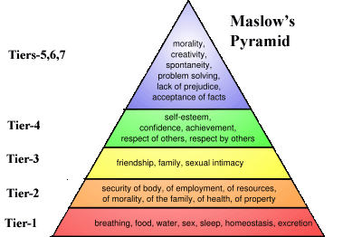
Hierarchy of Needs

Slide 18
Biopsychosocial Model
Components
Cartesian Model – Ascending Nociceptive Input from the periphery (Biomedical Model)
Gate Control Theory – descending modulation that inhibits or facilitates nociception.
“Central Processes”
  -neurological(as described above)
  -affective
  - cognitive

Slide 19
Biomedical Model components
  Cartesian Model (Descartes- 1644)
    Peripheral activation of pain pathways
    Locate structural cause of pain
    “Fix” or eliminate structural cause of pain = cure
    Inherent Limitations
  Usually points to a single physical pain generator
  Treatment focuses on single pain generator
  Cure through treatment of a single physical/structural pain generator is often unattainable due to multifaceted etiology of many conditions (examples)

Slide 20
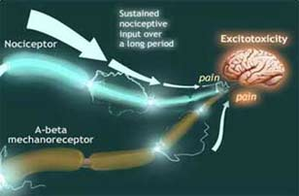
Excitotoxicity

Slide 21
“Central Processes” defined
    NEUROLOGICAL (cont’d)
Liebenson-less than 20% of back pain is caused by structural factors.
Nociception - the neural processes of encoding and processing noxious stimuli. It is the afferent activity produced in the peripheral and central nervous system by stimuli that have the potential to damage tissue. This activity is initiated by nociceptors, (also called pain receptors), that can detect mechanical, thermal or chemical changes, above a set threshold. Once stimulated, a nociceptor transmits a signal along the spinal cord, to the brain.

Slide 22
The Other 80 %...........????? From the Patients Perspective
Affective - refers to the experience of feeling or emotion.
Cognitive – (Cognition) refers to one’s ability to perceive, interpret, understand, and process information, given a healthy growth environment.
Liebenson – “perception of pain is heavily influenced (both by nociception and) by one’s attitudes, beliefs, and social environment”.

Slide 23
Biopsychosocial Model
Illness Behavior
Psychogenic Distress
Attitudes and Beliefs
Pain

Slide 24
Social Environment/Information Overload
A. Biomedical model limitations/failures (Liebenson)
  Overemphasis on structural diagnosis
  Over prescription of bed rest
  Overuse of Surgery
  B. Biomedical Model Complicating Factors
  4. overemphasis on pharmaceutical management
  5. insurance based acute care focus
  6. Societal psychological mindset =no pain means no problem

Slide 25
Overemphasis on structural diagnosis
Overuse of diagnostic imaging, MRI, etc. to rule out serious diseases/ “Red Flags”(tumors, infections, etc.)
Structural Pathologies that can only be identified with imaging are misrepresented as being strongly correlated with symptoms during the ROF. (herniated discs, arthritis, etc.)
The occurrence of false positives
    -28 to 50% of asymptomatic individuals—low back
    -Possibly as high as 75%--cervical spine
    -false-positives/future problems

Slide 26
Overuse of Surgery
Bigos and Battie – only appropriate for 2% of the population, and it’s inappropriate use can have a great impact on increasing the chance of chronic pain disability.
Bush – (1992) 86% of patients with clinical sciatica and radiologic evidence of nerve root entrapment were treated successfully by aggressive conservative management

Slide 27
Surgical intervention
Almost Certain Surgical Criteria
  Cauda Equina Syndrome
  Paresis (partial loss of movement)that is rapidly progressive despite a trial is conservative care of four weeks to three months

Slide 28
Rand Corporation
Surgical indications for disc herniation or stenosis
  Pain in the lower limb with positive imaging major either neurological findings after restricted activity for more than six weeks
    minor neurological findings(two or more)
      Asymmetric DTR
      Positive ipsilateral straight leg raise (SLR)
      Sciatica
      Dermatomal sensory deficits
      Major neurological findings
        Progressive unilateral leg weakness
        Positive contralateral SLR test

Slide 29
Abnormal Illness Behavior
LaRocca 1991 in his presidential address to the Cervical Spine Research Society’s annual meeting—
If pathology is a major cause of symptoms
And prescribed/appropriate treatment patient doesn’t recover
Then incorrectly assume psychogenic and label as such
Acute pain
  Painful stimuli
  Nociception
  Tissue injury
    Chronic pain
      SMALL PORTION

Slide 30
Chronic Pain.. continued
Locomotor pain = impaired function(functional disorder)
  Nonspecific/idiopathic (not injury related)
    Long-term physiologic compensatory behaviors (Innate)
    Muscle/joint dysfunction plus chronic soft tissue irritation equals pain generation
    Acute-care protocols (most office setups) are doomed to failure because:
      they are injury-site specific
      Acute pain requires reduced activity whereas chronic pain requires controlled, biomechanical, rehabilitative, progressively increasing activity levels

Slide 31
Chronic Pain…. continued
Dysfunctional Compensatory Pathology
  Innate helped the body survive with limitations
  Excessive scar tissue development, restricted motion, chronic subluxation, increased pain perception, decreased activity, physiologic recruitment, all contribute to the following:
      Excess strain/”wear and tear” on the anatomy usually away from the initial injury site
      Secondary strain becomes primary pain generator
      Overuse of normal healthy tissue causes breakdown/injury
      define chronic illness

Slide 32
Chronic Pain… continued
(slide 29) Remaining Factors
  Affective
    Anxiety
    Depression
Cognitive ( coping)
  Fear –avoidance behavior
  Ignoring stop rules
  Catastrophising the low back problem
    Ruptured disc
    Degenerative arthritis

Slide 33
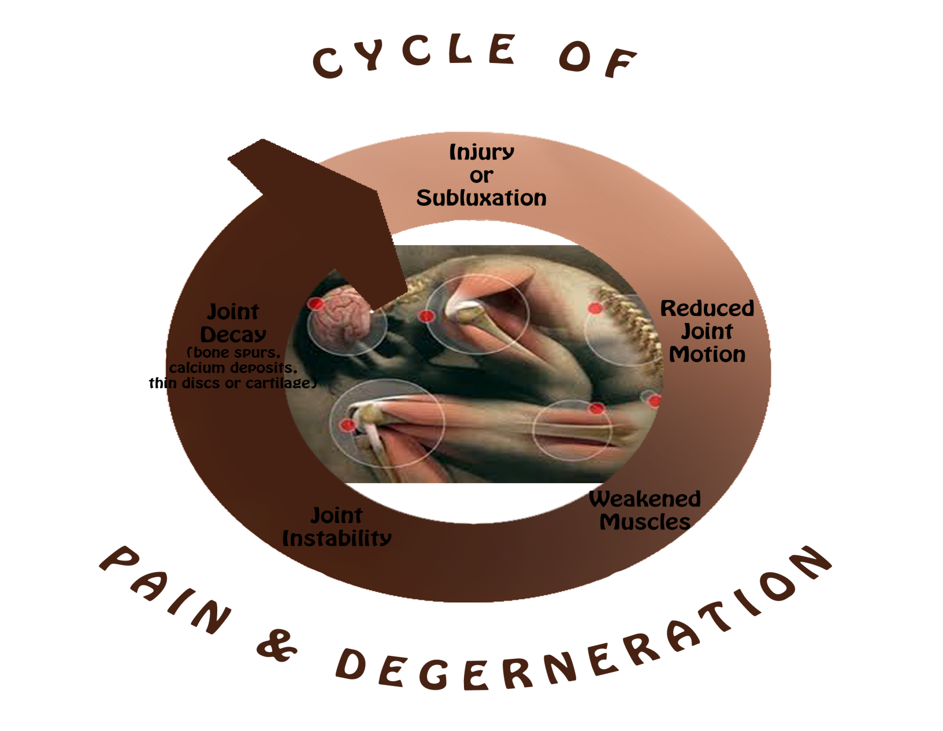
Normal/Acute

Slide 34
Fear-Avoidance Behavior
1.Fear of pain
2.Activity avoidance
3.deconditioning
4.Acute tissue overload and chronic sensitization

Slide 35
Ignoring “Stop” Rules
An arbitrary set of rules set up by the chronic pain patient to help them make the decision to stop certain activities because they generate/initiate pain.
  The list intends to grow as your body continues to be deconditioned
  A weakened muscular system creates a perpetual cycle where less activity triggers pain which then forces chronic pain suffer to become less active.
  Soon they feel trapped because minimal activity generates pain

Slide 36
“Catastrophising”
Nothing relieves pain
Increased pharmaceutical use coupled with less pain relief(tolerance)
An expanding list of “things I can’t do anymore because of the pain”
No one can help me……..then it must be serious
  Ruptured disk
  ( serious, irreparable)degenerative arthritis
  They must’ve missed something life-threatening

Slide 37
Keys to Recovery 7 R’s (Liebenson)
Rule out (red flags)
Reassurance(Klassen – 43% see doctor just for this)
Reactivation (formulas :50/50)
Relieve pain
Reevaluation
Rehabilitate/recondition/reeducate
Refer

Slide 38
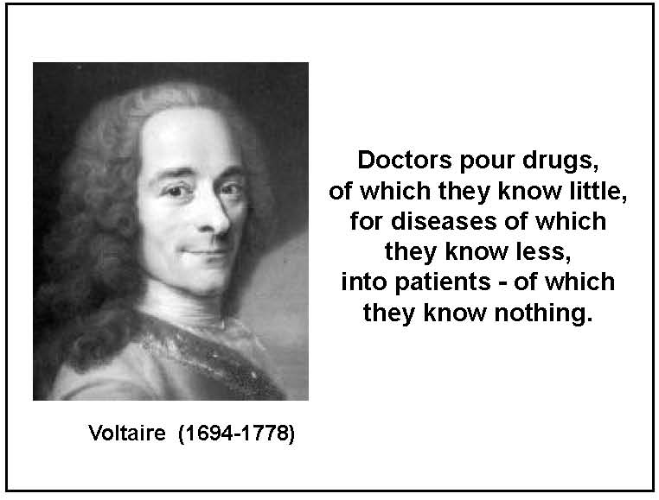

Slide 39
Neurotransmitters/Depression
Pharmaceutical
Selective Serotonin (Serotonin Specific) Reuptake Inhibitors (SSRI’s)
  Paxil
  Prozac
  Zoloft
  Celexa/Lexapro
  Cymbalta
  All of these inhibit serotonin from being re-absorbed while in the synapse so there is more time for “less” serotonin to be used by the CNS.

Slide 40
FROM: Webmd.com 2010
“Antidepressant medications that work on serotonin levels -- medications known as SSRIs (selective serotonin reuptake inhibitors) and SNRIs (serotonin and norepinephrine reuptake inhibitors) are believed to reduce symptoms of depression, but exactly how they work is not yet fully understood.”
…………….. REALLY?

Slide 41
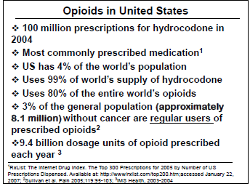
Chronic pain/Biomedical Model
Pharmaceutical Management

Slide 42
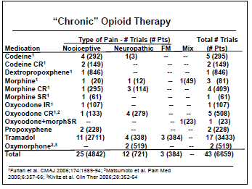
Commonly Prescribed

Slide 43
Some of the answers….
HYDROCODONE V.S. OXYCODONE == THESE TWO DRUGS ARE SIMILAR, BUT NOT the same.
Hydrocodone is the generic name for??????????.
  It is a narcotic analgesic, and not quite as strong as Oxycodone. It's also SLIGHTLY less regulated ie..……….it CAN BE CALLED IN to a pharmacy by a physician. It can be habit forming.
  a combo of hydrocodone and acetaminophen (Tylenol).
  Oxycodone is also a narcotic analgesic, also can be habit forming. It's also a combo of acetaminophen and oxycodone (generic) name for Percocet, Tylox, Roxilox.
  It is SLIGHTLY more regulated ie.. It CANNOT be called in to a pharmacy, you have to have a physical written prescription from a physician. Because of it's potential for abuse and dependence, doctors tend to order Vicodin rather than Percocet.

Slide 44
QUIZ
1.Oxycodone is what brand name(most common)?
2.Hydrocodone is what brand name(most common)?
    Both are the same but different potencies…
3.Both contain a powerful opioid and ???? And what common OTC pain reliever….?
  4. Opioid= What plant is this prescription drug derived from?
    5. Name at least 2 illegal/illicit drugs derived from the same plant?
  6. BONUS>>>>>Why create 2 of the same drugs at different potencies?

Slide 45
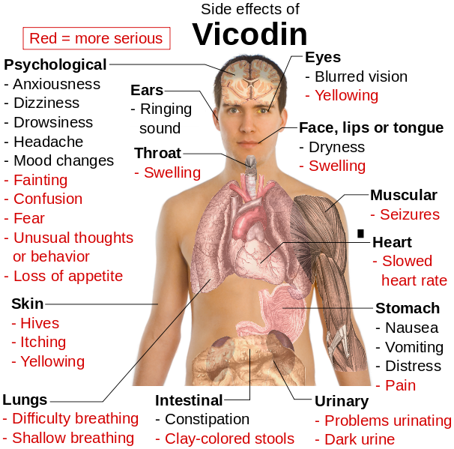

Slide 46
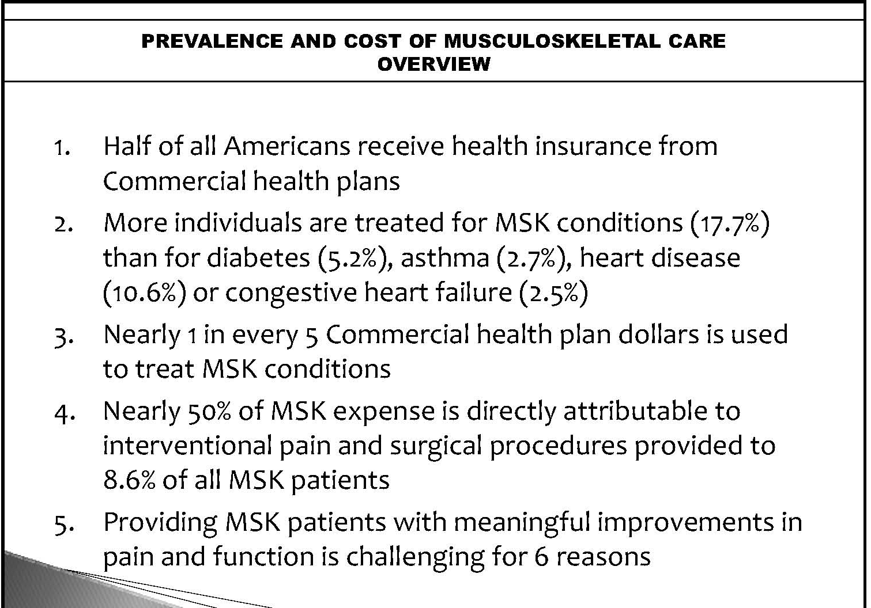
Cross section of Medical Insurance Providers across US 2009(sample= 1 million)

Slide 47
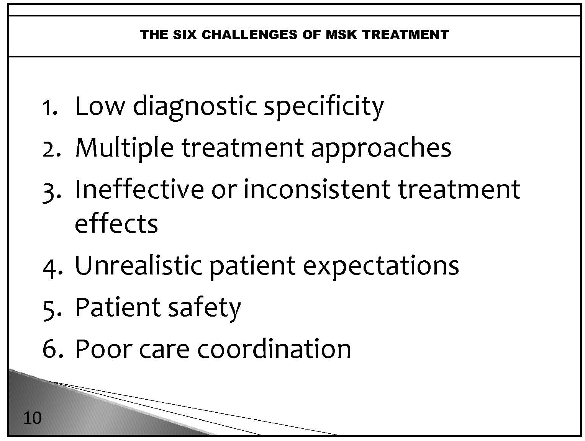

Slide 48
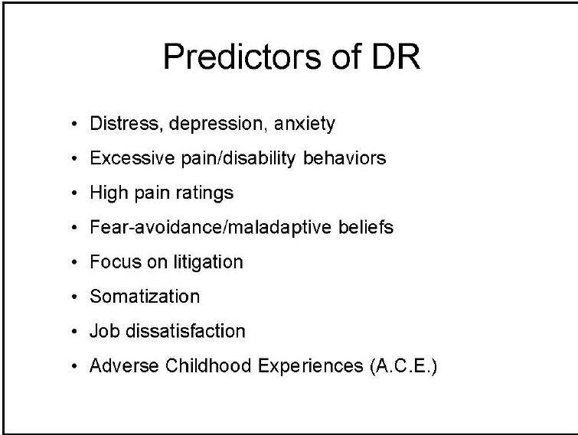
Delayed Recovery

Slide 49
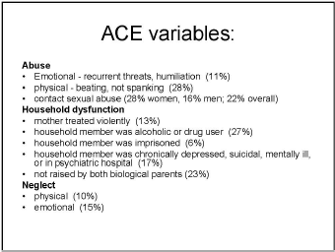
ADVERSE CHILDHOOD EXPERIENCES

Slide 50
Stereotyping
Kenneth Craik– Mental Modeling
-prominent UK Psychologist (Craik Award)
-Early to mid 1900s
--

Slide 51
Stereotyping: A Definition
Stereotyping can be defined as the process by which people use social categories (e.g. race, sex) in acquiring, processing, and recalling information about others.
Stereotyping beliefs may serve important functions - organizing and simplifying complex situations and giving people greater confidence in their ability to understand, predict, and potentially control situations and people.

Slide 52
Stereotyping: Risks
Can exert powerful effects on thinking and actions at an implicit, unconscious level, even among well-meaning, well-educated persons who are not overtly biased.
Can influence how information is processed and recalled.
Can exert “self-fulfilling” effects, as patients’ behavior may be affected by providers’ overt or subtle attitudes and behaviors.

Slide 53
Stereotyping: When Is It in Action?
Situations characterized by time pressure, resource constraints, and high cognitive demand promote stereotyping due to the need for cognitive ‘shortcuts’ and lack of full information.

Slide 54
What is the Evidence that Physician Biases and Stereotypes May Influence the Clinical Encounter?
Van Ryn and Burke (2000) - study conducted in actual clinical settings found that doctors are more likely to ascribe negative racial stereotypes to their minority patients. These stereotypes were ascribed to patients even when differences in minority and non-minority patients’ education, income, and personality characteristics were considered.
Finucane and Carrese (1990) - Physicians more likely to make negative comments when discussing minority patients’ cases.

Slide 55
What is the Evidence that Physician Biases and Stereotypes may Influence the Clinical Encounter (cont’d)?
Rathore et al. (2000) – found that medical students were more likely to evaluate a white male “patient” with symptoms of cardiac disease as having “definite” or “probable” angina, relative to a black female “patient” with objectively similar symptoms.
Abreu (1999) – found that mental health professionals and trainees were more likely to evaluate a hypothetical patient more negatively after being “primed” with words associated with African American stereotypes.

Slide 56
Findings
Racial and ethnic disparities in health care
exist and are associated with worse outcomes.
They occur in the context of broader historic and contemporary social and economic inequality in many sectors of American life.
Many sources – including health systems, health care providers, patients, and utilization managers – contribute to racial and ethnic disparities in health care.

Slide 57
Suicide in the U.S.: Statistics NIMH(National Institute of Mental Health)
What are the risk factors for suicide?
Research shows that risk factors for suicide include:
depression and other mental disorders, or a substance-abuse disorder (often in combination with other mental disorders). More than 90 percent of people who die by suicide have these risk factors.
stressful life events, in combination with other risk factors, such as depression. However, suicide and suicidal behavior are not normal responses to stress; many people have these risk factors, but are not suicidal.
prior suicide attempt
family history of mental disorder or substance abuse
family history of suicide
family violence, including physical or sexual abuse
firearms in the home, the method used in more than half of suicides
incarceration
exposure to the suicidal behavior of others, such as family members, peers, or media figures.

Slide 58
Suicide in the U.S.: Statistics ……cont.
NIMM(National Institute of Mental Health)
Research also shows that the risk for suicide is associated with changes in brain chemicals called neurotransmitters, including serotonin. Decreased levels of serotonin have been found in people with depression, impulsive disorders, and a history of suicide attempts, and in the brains of suicide victims
Are women or men at higher risk?
Suicide was the eighth leading cause of death for males and the sixteenth leading cause of death for females in 2004.¹
Almost four times as many males as females die by suicide

Slide 59
Suicide in the U.S.: Statistics ……cont.
NIMM(National Institute of Mental Health)
In 2004, suicide was the third leading cause of death in each of the following age groups. Of every 100,000 young people in each age group, the following number died by suicide:
Children ages 10 to 14 — 1.3 per 100,000
Adolescents ages 15 to 19 — 8.2 per 100,000
Young adults ages 20 to 24 — 12.5 per 100,000

Slide 60
Causes of Death 1/2008 CDC
15-24 years (released 1/16/08 by Center for Disease Control CDC)
1: Accidents and adverse effects. . . Motor vehicle
accidents All other accidents and adverse effects
2: Homicide and legal intervention
3: Suicide
4: Malignant neoplasms, including neoplasms of lymphatic and hematopoietic tissues
5: Diseases of heart 6: Human immunodeficiency virus infection 7: Congenital anomalies 8: Chronic obstructive pulmonary diseases, etc, 9: Pneumonia and influenza 10: Cerebrovascular diseases

Slide 61
Prevalence(%) of Psychiatric Disorders in the USA
Disorder Lifetime 12mos
Psychiatric 48.0 29.5
Affective 19.3 11.3
Major Depression 16.2 6.6
Anxiety Disorder 24.9 17.2
Substance Abuse 26.6 11.3
Goldberg, R.J. The Care of the Psychiatric Patient 3rd ed. 2007

Slide 62
Mental health problems among young doctors: an updated review of prospective studies. (a little too close to home???)
Harv Rev Psychiatry. 2002 May-Jun;10(3):154-65.
Tyssen R, Vaglum P.
Department of Behavioural Sciences in Medicine, Faculty of Medicine, University of Oslo, Oslo, Norway. reidar.tyssen@basalmed.uio.no
Previous studies have shown the medical community to exhibit a relatively high level of certain mental health problems, particularly depression, which may lead to drug abuse and suicide. We reviewed prospective studies published over the past 20 years to investigate the prevalence and predictors of mental health problems in doctors during their first postgraduate years. We selected clinically relevant mental health problems as the outcome measure. We found nine cohort studies that met our selection criteria. Each of them had limitations, notably low response rate at follow-up, small sample size, and/or short observation period. Most studies showed that symptoms of mental health problems, particularly of depression, were highest during the first postgraduate year. They found that individual factors, such as family background, personality traits (neuroticism and self-criticism), and coping by wishful thinking, as well as contextual factors including perceived medical-school stress, perceived overwork, emotional pressure, working in an intensive-care setting, and stress outside of work, were often predictive of mental health problems.

Slide 63
Neurotransmitters/Depression
Serotonin-controls many vital human functions
  Major help in regulation of: hunger, thirst, mood, breathing, sleep, confidence, perspective, self esteem, empathy, attitude
  Diet needs: Tryptophan, B-complex, 5HTP
  Tryptophan-major foods: cottage cheese, basil leaves, yogurt, eggs, Lean meat, nuts, beans, fish, and cheese.
  specific cheeses-Cheddar, Gruyere, Swiss
  avoid blue cheese,processed(amines)
  B-Complex (B6) …converts tryptophan into serotonin
  -Folate-broccoli, cabbage, asparagus, spinach, Kale
  -Folic acid-whole grain breads and cereals
  5HTP:(5 hydroxytryptophan)

Slide 64
Folate Sources
Folate is abundant in many vegetables and legumes, all of which are members of the World's Healthiest Foods. Excellent sources of folate include spinach, asparagus, turnip and mustard greens, broccoli, cauliflower, beets, celery, cabbage, zucchini, lentils, and Brussels sprouts. Very good sources include squash, cucumber, black beans, pinto beans, and garbanzo beans.

Slide 65
B-Vitamins/depression
B1- Thiamin
B2- Riboflavin/Niacin
B6- Pyrodoxine/Folacin
B12- Cobalomine

Slide 66
Mental Health Treatment Facts
50% of people with mental health disorders first diagnosed by PCP
40% of patients seeing PCP have a diagnosable mental health disorder
85% of patients with anxiety or depressive disorders sought help from PCP
Only 19% received adequate treatment

Slide 67
Legal Issues/Precautions
(weighing the issues)
Commitment to Care/Practitioner Limitations
The Right to Treatment/The Right to Refuse Treatment
Chiropractic claims/Verifiable Research
Abandonment-be careful what you promise
Competency
Malpractice
Confidentiality

Slide 68
Role of Portal of Entry Doctor
Complete evaluation
How do I Know if there is a need for mental health services-preliminary findings
  History

Slide 69
Role of Portal of Entry Doctor
Complete evaluation
Determine the need for mental health services-preliminary diagnosis
Explain the purpose
Obtain a release of information
Make the referral directly
Followup on compliance

Slide 70
Assessment
Mental Status Exam
  Presentation
  State of Consciousness
  Attention
  Speech Orientation
  Mood & Affect
  Form of thought

Slide 71
Mental Status Exam Contin.
  Thought Content
  Perceptions
  Judgment
  Memory
  Intellectual Functioning

Slide 72
Methods of Assessment
Psychological Assessment
EEG
Computed tomography CT
Magnetic resonance imaging MRI
Positron Emission Tomography PET
Single-photon emission computed tomography SPECT

Slide 73
Psychiatric Problems in Medical Care
Fatigue
Insomnia
Chronic medical conditions
Myocardial infarction
Generalized anxiety
Elderly

Slide 74
Psychiatric Problems in Medical Care (con.)
Depression
Panic Disorder
Somatization Disorder
Substance Abuse
Psychosocial

Slide 75
Basic Theories of Counseling and Psychotherapy
Psychoanalysis
Existential-Humanistic
Reality Therapy
Behavior Therapy
Cognitive-Behavior Therapy
Family Systems

Slide 76
Psychoanalysis
“Individual Psychology, Self psychology Object Relations”
Childhood determines later life psychological issues
Treatment long-term, expensive
Methods: Passive, Free association, dream analysis

Slide 77
Principles of Existential-Humanistic Approach
Capacity of self-awareness
Freedom and responsibility
Search for meaning, purpose ,values goals
Anxiety is a condition of living

Slide 78
Existential Humanistic Therapists
Existential Therapy- Victor Frankl Meaning, purpose, and love
Person Centered Therapy- Carl Rogers
Unconditional positive regard
Gestalt Therapy-Fritz Perls
Experiential here and now

Slide 79
Reality Therapy
Problems due to unsatisfactory relationships and choices
Therapy Process
Explore wants, needs, perceptions
Direction and doing in the present
Evaluation
Planning and commitment

Slide 80
Behavior Therapy
psychotherapy that focuses on changing and gaining control over unwanted behaviors
focuses on thought patterns
Active collaborative approach
Based on principles of learning:
operant conditioning and classical conditioning
Ivan Pavlov and B. F. Skinner

Slide 81
Cognitive Behavioral Therapy
Thoughts first …….Then actions
Cognitive processes such as “self-talk” mediate behavior change
Setting goals
Target behaviors to change=PHOBIA(irrational fears)
Types
Flooding=confronted by the fear object for an extended length of time without the opportunity to escape.
Systematic desensitization=imagine the events that cause anxiety while engaging in a series of relaxation exercises.

Slide 82
Thought Record
Situation
Mood Rating
Automatic Thought
Evidence that supports the thought
Evidence that does not support the thought
Alternative balanced thought
Mood Rating

Slide 83
Family Therapy
Involves a systems approach
Active and focus on interrelationships
Patterns of the family system
Genograms and explore family themes and patterns
Essential for treatment of children and adolescence

Slide 84
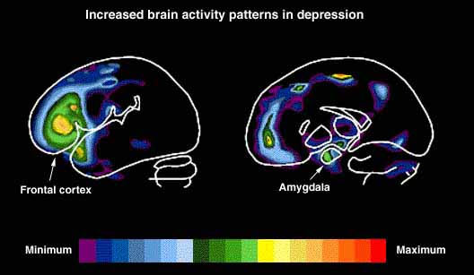
The data showed distinctive patterns of activity in the ventromedial prefrontal cortex (VMPFC) and the right prefrontal cortex (PFC), areas that regulate the emotional output generated from the amygdala. The VMPFC is compromised in depression, likely because of the inappropriate engagement of right PFC circuitry in depressed individuals.

Slide 85
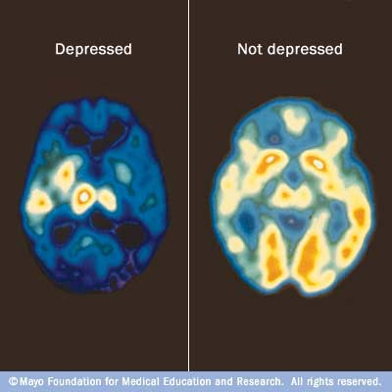
MRI

Slide 86
DSM-IV-TR
Diagnostic & Statistical Manual of Mental Disorders
Fourth Edition Text Revision
American Psychiatric Association=1994
DSM - V MAY 2013

Slide 87
Axis I
Clinical Disorders…-assesses individual's present clinical status/condition
- CLINICAL SYNDROMES that may be focus of clinical attention, such as:
schizophrenia, GAD, MDD, substance dependence
-Axis I conditions are roughly analogous to illnesses/diseases in general medicine…
Practically speaking…………. WHAT IS THE “DIAGNOSED” CONDITION WHEN THE PATIENT INITIALLY ENTERED THE PSYCHIATRIC/MENTAL HEALTH SYSTEM(may require further evaluation)

Slide 88
Axis II
longstanding personality traits:
(may or may not be involved in development of Axis I disorder) & MENTAL RETARDATION
-encompasses problematic ways of relating to world, such as:
histrionic personality disorder, paranoid personality disorder, antisocial personality disorder
-more than one diagnosis permissible

Slide 89
Axis III
GENERAL MEDICAL CONDITIONS
-potentially relevant to understanding/managing case such as:
Cirrhosis, Overdose, chemical Dependancy
Heart disease
Cancer
????
What would/could you as DC’s add????

Slide 90
Axis IV
PSYCHOSOCIAL/ENVIRONMENTAL problems:
STRESSORS that may contribute to current disorder and/or……..
-those that have been present during prior year
checklist approach for various categories of problems:
family, economic, occupational, legal
-for example:
Problems with primary support group, arrests, hospitalizations, ???

Slide 91
Axis V
Global Assessment of Functioning
Current, Highest Level in Past Year, At Discharge
clinicians indicate how well individual is coping at present time
-scale from 1 to 100
-60-70 mild symptoms (depressed mood, mild insomnia, mild difficulty in social/occupatnl/school fnctning)
-50-60 moderate symptoms (flat affect, occasional panic attacks, moderate diff. soc/occuptnl/school fncting) -40-50 serious symptoms (suicidal ideation, severe obsessional rituals, serious imprmt. soc/occ/school fncting)
-30-40 impairment in reality testing/communicating (speech illogical/obscure/irrelevant, or maj. imprmnt soc/occ/sch)

Slide 92
Axis V (continued)
20-30 behavior considerably influenced by delucions/hallucinations (incoherent, inappropriate behavoir, suicidal preoccupation; inability to function almost all areas)
10-20 danger of hurting self/others (suicide attempts, violent, manic excitement, failure to maintain hygiene)
1-10 persistent danger of hurting self/others, inability to maintain personal hygiene, serious suicidal attempt

Slide 93
NIMH Mental Disorders in America**
All Depressive Disorders
18.8 million (9.5%)
Nearly twice as many women (12%) as men (6.6%)-12.4 million women & 6.4 million men
Occurring earlier in life in people born in recent decades
Co-morbidity with anxiety and substance abuse
http://www.youtube.com/watch?feature=player_detailpage&v=MdHg6_pDbSI

Slide 94
NIMH Mental Disorders in America**
Dysthymic Disorders
5.4% during their lifetime (10.9 million)
40% also meet criteria for major depressive disorder or bipolar in a given year
Often begins in childhood, adolescence or early adulthood

Slide 95
NIMH Mental Disorders in America**Con’t
Bipolar Disorder
2.3 million (1.2%)
Men and women – equally likely to develop
Average age onset for the first episode - early 20’s
**Annually for adults 18 yrs and older in US

Slide 96
Suicide in America
30,000 people die by suicide
Significant majority – white males over 45
More than 90% - diagnosable mental disorder
Third leading cause of death in 15-24 yr olds
Four times as many men as women die, women attempt 2-3 times more often
Depression or alcohol – 75% of all suicides
TCA’s – most commonly used antigepressants in suicide attempts

Slide 97
Short-Term (6-12mo) Risk Factors for Suicide
Obsessive-compulsive features
Severe hopelessness
Panic, severe anxiety and agitation
Global insomnia
Severe cognitive difficulties and psychotic thinking
Lack of friends in adolescence
Acute overuse of alcohol
Recurrent depression

Slide 98
Necessary Terminology
Manic episode
Major depressive episode
Mixed episode
Hypomanic episode
Episodes do not have their own diagnostic codes and cannot be diagnosed as separate entities. They serve as building blocks for the diagnostic disorders known as Mood Disorders.

Slide 99
Necessary terminology cont.
delusions (false, strongly held beliefs not influenced by logical reasoning or explained by a person’s usual cultural concepts).
  These erroneous beliefs usually in fall for a misinterpretation of perceptions or experiences
  Themes include: persecution,referential, religious or grandiosity with persecution being the most common including the belief one is being tormented, followed, tricked, spied on.
  Referential-certain comments, gestures, passages from books, song lyrics, are directed specifically at them

Slide 100
Terminology continued
psychosis (or psychotic symptoms). Common psychotic symptoms are hallucinations (hearing, seeing, or otherwise sensing the presence of things not actually there)
Usually much longer duration (at least a month)
Usually considered much more severe than delusions

Slide 101
Criteria for Manic Episode
A distinct period of abnormally and persistent elevated, expansive, or irritable mood.
Consists of at least 3 of the following symptoms and lasting at least 1 week with marked impairment of functioning:

Slide 102
Criteria for Manic Episode Con’t
Inflated self-esteem or grandiosity
Decreased need for sleep
More talkative or pressure to keep talking
Flights of ideas or subjective experiences that thoughts are racing
Distractibility
Increase in goal directed activity or psychomotor agitation
Excessive involvement in pleasurable activities that have a high potential for painful consequences

Slide 103
Criteria for Hypomanic Episode
Consists of at least 3 of the following symptoms and lasting 4 days without marked impairment of functioning:

Slide 104
Criteria for Hypomanic Episode Con’t
Inflated self-esteem or grandiosity
Decreased need for sleep
More talkative or pressure to keep talking
Flights of ideas or subjective experiences that thoughts are racing
Distractibility
Increase in goal directed activity or psychomotor agitation
Excessive involvement in pleasurable activities that have a high potential for painful consequences

Slide 105
Criteria for Major Depressive Episode
A period of depressed mood with a loss of interest in nearly all activities.
Consists of 5 or more of the following symptoms lasting at least 2 consecutive weeks and represent a change from previous functioning;
Must include one of the first two symptoms of either (1) depressed mood or (2) loss of interest or pleasure.

Slide 106
Criteria for Major Depressive Episode Con’t
Depressed mood
Diminished interest
Significant weight loss
Insomnia or hypersomnia
Psychomotor agitation or retardation
Fatigue or loss of energy
Feelings of worthlessness or guilt
Diminished ability to concentrate or indecisiveness
Recurrent thoughts of death

Slide 107
Mixed Episode
The criteria for both a manic episode and the major depressive episode nearly every day during at least a one week period.
The mood disturbance is sufficiently severe to cause marked impairment in occupational functioning, usual social activities or relationships, or hospitalization to prevent harm to self or others.
Symptoms are not do to direct physiological effects of substance(i.e.,medication, electroconvulsive therapy, a drug of abuse) or a general medical condition.

Slide 108
DSM-IV-TR Mood Disorders
Mood disorder due to a general medical condition
Substance-induced mood disorder
Mood disorder not otherwise specified

Slide 109
DSM-IV-TR Mood Disorders
Depressive Disorders( unipolar depression)
Major Depressive Disorder
Single, Recurrent
Melancholic, psychotic, atypical, seasonal
-the primary characterization of this disorder is one or more major depressive episode.
Dysthymic Disorder
Early, Late Onset
Depression not otherwise specified

Slide 110
DSM-IV-TR Mood Disorders
Bipolar Disorders
Bipolar I
Manic, mixed, depressed
Bipolar II
Hypomanic, depressed
Cyclothymic disorder
Bipolar disorders not otherwise specified

Slide 111
DSM-IV-TR Mood Disorders
Mood disorder due to a general medical condition
Substance-induced mood disorder
Mood disorder not otherwise specified

Slide 112
Criteria for Major Depressive Episode,Con’t
Depressed mood
Diminished interest
Significant weight loss
Insomnia or hypersomnia
Psychomotor agitation or retardation
Fatigue or loss of energy
Feelings of worthlessness or guilt
Diminished ability to concentrate or indecisiveness
Recurrent thoughts of death

Slide 113
Criteria for Dysthymic Disorder
Depressed most of the day
Consists of 2 or more of the following symptoms lasting for at least 2 years
  Poor appetite
  Insomnia or hypersomnia
  Low energy or fatigue
  Low self-esteem
  Poor concentration or difficulty making decisions
  Feelings of hopelessness

Slide 114
Criteria for Adjustment Disorder with Depressed Mood
Development of depressive symptoms in response to an identifiable stressor occurring within 3 months of the onset of the stressor;
Characterized by either marked distress in excess to the stressor or significant impairment in social or occupational functioning;
Does not last past 6 mos. of exposure to stressor.

Slide 115
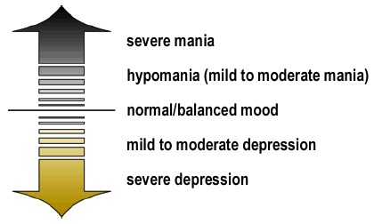
Affective Continuum (emotional extremes)

Slide 116
Criteria for Cyclothymic Disorder
Chronic fluctuating mood disturbance involving numerous periods of hypomanic symptoms and numerous periods of depressive symptoms for at least 2 years;
During the 2 yr. Period, any symptom free intervals last no longer than 2 months;
No major depressive disorder or manic episode has been present.

Slide 117
Criteria for Bipolar Disorder
Bipolar I
The occurrence of 1 or more manic episodes or mixed episodes
Bipolar II
The occurrence of 1 or more major depressive episodes accompanied by 1 hypomanic episode
http://www.youtube.com/watch?v=2OfNPiZz3Lw&feature=player_embedded

Slide 118
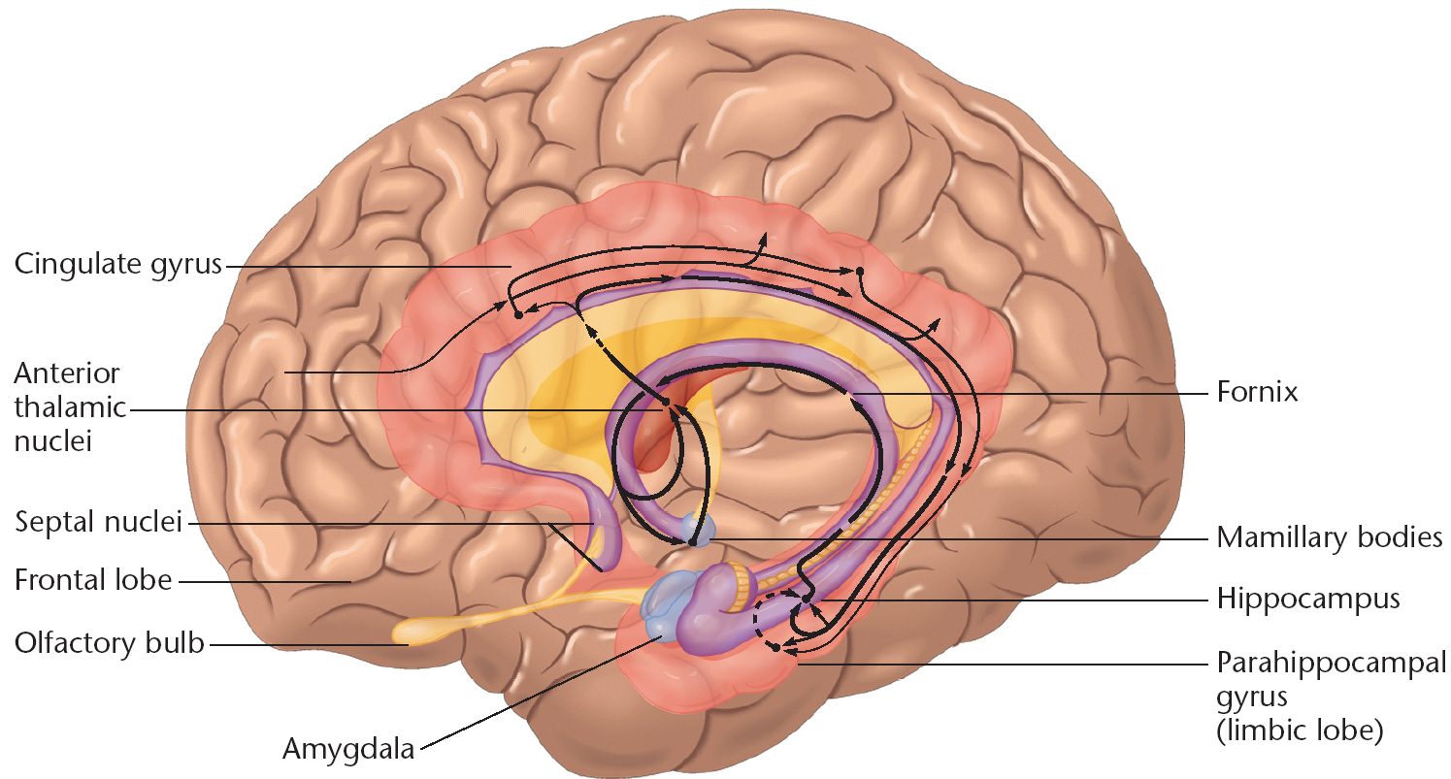

Slide 119
Biology of Emotions
Sadness
Right prefrontal and parietal cortex
Subgenual anterior cingulate BA 25
Left ventral lateral prefrontal cortex BA 47
Dorsolateral prefrontal cortex BA 9/46 right hemisphere

Slide 120
Biology of Fear/Anxiety
  Amygdala
Locus Coeruleus
Neuropeptides CRH, Y, CCK, ACTH
Dorsolateral prefrontal cortex

Slide 121
Biology of Anger
Orbitofrontal cortex
Ventral anterior cingulate cortex
Neuropeptides Substance P

Slide 122
Happiness/Reward
Basal ganglia (ventral striate & putamen)
Hypothalamus
Ventral tegmental area
Neuropeptides: neurotensin, glutamate, opiods

Slide 123
Medical Causes of Depression
Autoimmune Disorders
Cerebrovascular disease
Endocrine disorders
Epilepsy
Infections

Slide 124
Medical Causes continued
Metabolic Disorders
Neurologic Disorders
Sleep Apnea
Structural Brain disease
Malignancies

Slide 125
Substances causing Depressive Symptoms
Alcohol
Anabolic steroids
Anticholinergic agents
Anticonvulsant agents
Barbiturates
Benzodiazepines

Slide 126
Substances Causing Depression continued
Cimetidine
Clonidine
Corticosteroids
Oral contraceptives
Sedatives
Thiazides

Slide 127
Screening Tools
“Have you been feeling sad or depressed recently?”
Hamilton Depression Rating Scale
Beck Depression Inventory
Geriatric Depression Scale

Slide 128
Antidepressants
Tricyclics- e.g. elavil, sinequan pamelor
SSRI’s –e.g. Prozac, Paxil, Zoloft
SNRI’s e.g. Effexor,Cymbalta
5HT2 + SRI e.g. Desyrel, Serzone
Others: Wellbutrin, Remeron
MAO Inhibitors

Slide 129
Side Effects
Anticholinergic-dry mouth,blurred vision, constipation
Sedation
Activation
Orthostatic hypotension
Sexual
Cardiac Conduction Delay

Slide 130
Side Effects contin.
Seizures
Gastrointestinal
Suicide
Uncommon-SIADH (Syndrome of Inappropriate Antidiuretic Hormone Secretion; Extrapyramidal Side Effects (EPS); Bleeding; Cardiac Arryhthmias; Serotonin Syndrome

Slide 131
Alternative and New Treatment of Depression
Omega 3 Polyunsaturated Fatty acids and bipolar
Chromium
Inositol
Newer anticonvulsant and antipsychotics
ECT alternatives – Vagus nerve stimulation, repetitive transcranial magnetic stimulation (rTMS), magnetic seizure therapy

Slide 132
Alternative and New Treatment of Depression
6. Pindolol augmentation of SSRI
7. Ketoconazole for bipolar
8. Bright light therapy for SAD

Slide 133
DSM-IV-TR Anxiety Disorders
Panic disorders
    without Agoraphobia
    with Agoraphobia(clusters, avoided/stressful, rule out drugs,
Specific Phobia(cats, heights, bridges, etc)
Social Phobia(Social or performance situations, public scrutiny/criticism/embarrassment, situational panic attack, avoidance, interferes with normal routine or occupation and/or social life
Obsessive-Compulsive Disorder
Posttraumatic Stress Disorder
Acute Stress Disorder
Generalized Anxiety Disorder
Other Anxiety Disorders
    Due to a general medical condition
    Substance-induced

Slide 134
Criteria for Panic Attack
A discrete period of intense fear or discomfort in which 4 or more of symptoms develop abruptly and reach peak in 10 minutes or less:
1. palpations, pounding heart, or accelerated heat rate
2. sweating
3. trembling or shaking
4. sensations of shortness of breath or smothering

Slide 135
Criteria for Panic Attack, Con’t
5. feeling of choking
6. chest pain or discomfort
7. nausea or abdominal distress
8. feeling dizzy, unsteady, lightheaded, or faint
9. derealization (feelings of unreality) or depersonalization (being detached from oneself)
10. fear of losing control or going crazy
11. fear of dying
12. parasthesias (numbness or tingling sensations)
13. chills or hot flushes

Slide 136
Criteria for Panic Disorder
Both A and B
A. Recurrent unexpected panic attacks
B. At least 1 attack has been followed by 1 month or more of 1 or more of the following:
1. persistent concern about having additional attacks
2. worry about the implications of the attack or its consequences (e.g. losing control, having a heart attack, going crazy)

Slide 137
Criteria for Panic Disorder, Con’t
C. Panic attacks not due to substance abuse or medical condition
D. Panic attacks not better accounted for by another medical disorder such as OCD, Social Phobia or Specific Phobia
This disorder can be with or without agoraphobia

Slide 138
Social Phobia
Marked and persistent fear of one or more social situations
Exposure to the feared situations invoke anxiety or panic attack
The person recognizes the fear is excessive
Feared situations are avoided or endured
Avoidance or distress interferes with person’s normal routine

Slide 139
Social Phobia Con’t
6. In individuals under 18 the duration lasts for at least 6 months
7. The fear or avoidance is not due to substance abuse or general medical condition or another mental disorder
8. If medical condition is present the fear is unrelated to the medical symptoms

Slide 140
Key Symptoms of PTSD
1. Re-experiencing the traumatic event
- Intrusive, distressing recollections
- Flashbacks
- Nightmares
Exaggerated emotional and physical reactions to triggers that remind the person of the event
2. Avoidance of activities, places, thoughts, feelings, or conversations related to the trauma

Slide 141
Key Symptoms of PTSD Con’t
3. Emotional numbing
- Loss of interest
- Feeling detached from others
- Restricted emotions
4. Increased arousal
- Difficulty sleeping
- Irritability
- Difficulty concentrating
- Hypervigilance
- Exaggerated startle response

Slide 142
How to Recognize PTSD Con’t
The Impact of the Stressor
Must be extreme, not just severe, e.g., actual or threatened deaths, serious injury, rape, or childhood sexual abuse
Causes powerful subjective responses – intense fear,
http://www.pbs.org/now/shows/339/index.html

Slide 143
C0-Morbid Disorders with PTSD
Substance abuse or dependence
Major depressive disorder
Panic Disorder/agoraphobia
Generalized anxiety disorder
Obsessive-compulsive disorder
Social phobia
Bipolar disorder

Slide 144
Anorexia Nervosa
Refusal to maintain body weight at or above a minimally normal weight for age and height (weight loss leading to maintenance of body weight less than 85% of that expected; or failure to make expected weight gain during period of growth, leading to body weight loss less than 85% of that expected).

Slide 145
Anorexia Nervosa Con’t
B. Intense fear of gaining weight or becoming fat, even though underweight.
C. Disturbance in the way in which one’s body weight or shape is experienced, undue influence of body weight or shape on self-evaluation, or denial of the seriousness of the current low body weight.

Slide 146
Anorexia Nervosa Con’t
D. In postmenarcheal females, amenorrhea ie., the absence of at least three consecutive menstrual cycles.
Restrictive Type: not engaging in binge-eating or purging behavior .
Binge-Eating/Purging Type: regularly engaged in binge-eating or purging.

Slide 147
NIMH Longterm AN symptoms
thinning of the bones (osteopenia or osteoporosis)
brittle hair and nails
dry and yellowish skin
growth of fine hair over body (e.g., lanugo)
mild anemia, and muscle weakness and loss
severe constipation
low blood pressure, slowed breathing and pulse
drop in internal body temperature, causing a person to feel cold all the time
lethargy

Slide 148
Bulimia Nervosa
Recurrent episodes of binge eating. An episode is characterized by both of the following:
    1. Eating, in a discrete period of time (e.g. within any 2 hr period) an amount of food that is definitely larger than most people would eat during a similar period of time and under similar circumstance
    2. A sense of lack of control over eating during the episode (e.g. a feeling that one cannot stop eating or control what or how much one is eating

Slide 149
Bulimia Nervosa, Con’t
B. Recurrent inappropriate compensatory behavior in order to prevent weight gain, such as self-induced vomiting, misuse of laxatives, diuretics, enemas, or other medications; fasting; or excessive exercise
C. The binge eating and inappropriate compensatory behaviors both occur, on average, at least twice a week for 3 mos.

Slide 150
Bulimia Nervosa, Con’t
D. Self-evaluation is unduly influenced by body shape and weight
E. The disturbance does not occur exclusively during episodes of Anorexia Nervosa

Slide 151
Bulimia Nervosa, Con’t
Specific Type:
Purging Type: regularly engaged in self-induced vomiting or the misuse of laxatives, diuretics, or enemas
Non-purging Type: used other inappropriate compensatory behaviors, such as fasting or excessive exercise, but has not regularly engaged in self-induced vomiting or the misuse of laxatives, diuretics, or enemas

Slide 152
NIMH Other symptoms include:
chronically inflamed and sore throat
swollen glands in the neck and below the jaw
worn tooth enamel and increasingly sensitive and decaying teeth as a result of exposure to stomach acids
gastroesophageal reflux disorder
intestinal distress and irritation from laxative abuse
kidney problems from diuretic abuse
severe dehydration from purging of fluids
finger callouses

Slide 153
Typical Alcohol Progression
Social Drinkers – Most Americans are characterized as social drinkers. Statistics indicate, however, that one of every 16 drinkers will become alcoholic.
Warning Signs – The individual begins to drink more frequently and more than his associates. He drinks for confidence or to tolerate or escape problems. No party or other occasion is complete without a couple of drinks.

Slide 154
Typical Alcohol Progression, Con’t
Early Alcoholism – With increasing frequency, the individual drinks too much. “Blackouts” or temporary amnesia, occur during or following drinking episodes. He drinks more rapidly than others, sneaks drinks and in other ways conceals the quantity that he drinks. He resents any interference with his drinking habits.

Slide 155
Typical Alcohol Progression, Con’t
Chronic Alcoholism – The individual becomes a loner in his drinking. He develops alibis, excuses and rationalizations to cover up or explain his drinking. Personality and behavior changes occur that affect all relationships – family, employment, community. Extended binges, physical tremors, hallucinations and delirium, complete rejection of social reality, malnutrition with accompanying illness and disease and early death all occur as chronic alcoholism progresses.
Source: American Medical Association

Slide 156
Substance Dependence
A maladaptive pattern of substance use, leading to a critically significant impairment or distress as manifested by 3 or more of the following, occurring at any time in the same 12 month period:
1. Tolerance-either
a. a need to increase amounts to achieve intoxication
b. diminished effect with continued use of the same amount

Slide 157
Substance Dependence Con’t
2. Withdrawal-either
a. a characteristic withdrawal syndrome for the substance
b. the substance (or something close) is taken to relieve withdrawal
3. The substance is often taken in larger amounts or over a longer period than was intended
4. There is a persistent desire or unsuccessful efforts to cut down or control substance

Slide 158
Substance Dependence Con’t
5. A great deal of time is spent in activities necessary to obtain the substance
6. Important social, occupational, or recreational activities are given up or reduced because of substance
7. Substance use is continued despite knowledge of having a persistent or recurrent physical or psychological problem that is likely to have been caused or exacerbated by the substance

Slide 159
Ask yourself “Do I have a problem?”
C -- tried but failed to “cut” down
A -- Annoyed by criticism from others
G -- Guilt about consequences of drinking (ie, loss of job or relationship)
E -- Eye-opener (MVA or DUI etc)

Slide 160
Teenagers
About half of U.S. teens who start drinking alcohol before age 14 will be addicted to it at some point.
http://www.youtube.com/watch?feature=player_detailpage&v=uIbXvaE39wM
http://www.youtube.com/watch?v=UKWkQfoUQ6o&feature=player_detailpage

Slide 161
Disorders Usually First Diagnosed in Infancy, Childhood or Adolescence
Mental retardation
Learning Disorders
Motor Skills Disorders
Communication Disorders
Pervasive Development Disorders
Attention-Deficit and Disruptive Behavior Disorders

Slide 162
Disorders Usually First Diagnosed in Infancy, Childhood or Adolescence, Con’t
Feeding & Eating Disorders of Infancy or Early Childhood
Tic Disorders
Elimination Disorders
Other Disorders
- Separation Anxiety Disorders
- Selective Mutism
- Reactive Attachment Disorders
- Stereotypic Movement Disorders

Slide 163
Basic Language Development Autism Spectrum Disorders
- Semantic language: use and understand words, phrases and sentences; including abstract concepts and idioms.
Expressive verbal language: The ability to express our ideas with spoken words.
-Articulation: The ability to speak each word clearly.

Slide 164
Autism Spectrum Disorders(ASD) Skills less likely affected in ASD
(A) Verbal/Spoken Communication Skills
-Receptive verbal language: understand spoken words and ideas.
-Central Auditory Processing (CAP): abilities needed to process and derive meaning from sounds and words; including the abilities to distinguish between similar sounds, and to pick out the main voice from background. In short, “what we do with what we hear.”

Slide 165
Skills highly likely affected in ASD
(B) Non-Verbal/Non-Spoken Communication Skills “Theory of Mind.” : (1)that I have a mind, (2) that you have a mind; and most importantly, (3) that our minds may not know or be feeling the same things. Without a theory of mind, there is little point in communicating. After all, who would you be communicating to? There is limited ability to truly recognize that there is another human being in the room. It will be difficult to feel the need to communicate with anyone else. It may seem as if there is a plane of glass between the child and others. Eye contact will be poor. (Problematic in ASD)
-”get inside your mind”

Slide 166
Pragmatic language: The practical ability to use language in a social setting,
what is appropriate to say, where and when to say it;
the ability to figure out what the other person does or does not already know—or might or might not be interested in hearing about. Example :The teacher asks him where he comes from. The Autistic Spectrum child responds: “From the hallway.” This child’s spoken language is precise, but he misses (1) the actual meaning of the question; and more importantly, (2) misses that the whole purpose of this conversation was just a little fun chit-chat to initiate an interaction. The skill to know what is—and what is not—important Ability to see the big picture rather than fixate on details. Ability to maintain a full range of interests.

Slide 167
Symbolic play skills (representational meaning)
- Stuffed animals are not just warm rags of cloth to drag around, but living creatures that have feelings and needs.
- By 18 months, most toddlers start to use objects as symbols for something else.
- By 3 years of age, most children are quite good at “let’s pretend” activities, such as “You be the cowboy!”
---- the ability to recognize that the letters “C-A-T” stand for a furry animal.
----a cup is for drinking, but it also makes quite a handy telephone. Failure to develop representational/symbolic/pretend play is a strong marker of the Autistic Spectrum Disorders.

Slide 168
After all, if you cannot understand that a physical toy bus represents a real truck, how could you understand that the even more purely representational sound “bus” represents a real truck. Non-verbal (non-spoken) transmission of language. The simple sounds are not the only thing my body sends through space when it attempts to communicate with you. It also transmits:
Facial expressions
Body language
Tone and prosidy of voice

Slide 169
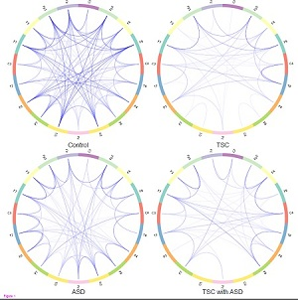
AUTISM and TSC (genetic syndrome) tuberous sclerosis complex (TSC) compared to ASD "It's a simpler, less specialized network that's more rigid, less able to respond to stimulation from the environment."

Slide 170
TSC and Autism(ASD)
In both groups with autism, brain networks had a seeming surplus of short-range connections within different brain region and relatively fewer connections linking far-flung areas. The redundancy of pathways within brain regions is consistent with previous research showing that young brains affected by autism lack the normal "pruning" of extra connections that normally takes place in infancy.

Slide 171
Pervasive Developmental Disorders
Autistism Spectrum Disorders
Rett’s - (female, normal prenatal/perinatal-5 months, normal psychomotor-5 months, head growth decelerates from 5-48 months, profound mental retardation) rare neurogenic disorder
Childhood Disintegrative- (primarily male, minimum of two years of normal development, significant loss of previously acquired skills before the age of 10.) 1/50,000

Slide 172
Autism Spectrum Disorders
(DSM-IV TR recognized)
AUTISM
ASPERGERS
PDD-NOS
RETTS
CDD

Slide 173
Autistic Disorder
Severely disordered verbal and non-verbal language; unusual behaviors.
Asperger’s Syndrome
Relatively good verbal language, with “milder” non-verbal language problems; restricted range of interests and relatedness.
PDD-NOS
Non-verbal language problems not meeting strict criteria for other PDD disorders.
Rett’s Disorder*
Childhood Disintegrative Disorder*
Neurologists are scratching their head on this one

Slide 174
Autism Spec. Disorders (NOT DSM-IV TR)
Semantic Pragmatic Communication Disorder
Delay /trouble with the use of language (both semantic and pragmatic), socialization relatively spared.
Non-Verbal Learning Disabilities
Trouble integrating information in 3 areas: non-verbal difficulties : misses major gestalt in language; spatial perception problems; and motor coordination .
High Functioning Autism
For some authors, synonymous with Asperger’s;
Hyperlexia
Most notable for incredible rote reading skills starting at an early age.

Slide 175
ASPERGERS
(I) Qualitative impairment in social interaction, as manifested by at least two of the following:
-(A) marked impairments in the use of multiple nonverbal behaviors such as eye-to-eye gaze, facial expression, body posture, and gestures to regulate social interaction
-(B) failure to develop peer relationships appropriate to developmental level
-(C) a lack of spontaneous seeking to share enjoyment, interest or achievements with other people, (e.g.. by a lack of showing, bringing, or pointing out objects of interest to other people)
(D) lack of social or emotional reciprocity

Slide 176
ASPERGERS
(II) Restricted repetitive & stereotyped patterns of behavior, interests and activities, as manifested by at least one of the following:
-(A) encompassing preoccupation with one or more stereotyped and restricted patterns of interest that is abnormal either in intensity or focus
-(B) apparently inflexible adherence to specific, nonfunctional routines or rituals
-(C) stereotyped and repetitive motor mannerisms (e.g. hand or finger flapping or twisting, or complex whole-body movements)
-(D) persistent preoccupation with parts of objects

Slide 177
ASPERGERS
  (III) The disturbance causes clinically significant impairments in social, occupational, or other important areas of functioning.
  (IV) There is no clinically significant general delay in language (E.G. single words used by age 2 years, communicative phrases used by age 3 years)
  (V) There is no clinically significant delay in cognitive development or in the development of age-appropriate self help skills, adaptive behavior (other than in social interaction) and curiosity about the environment in childhood.
  http://www.youtube.com/watch?v=VDMOLd1IUus&feature=player_detailpage

Slide 178
Aspergers……types
Autism
http://www.youtube.com/watch?feature=player_detailpage&v=JnylM1hI2jc
http://www.youtube.com/watch?v=m9S6xCNE3XE&feature=player_detailpage
http://www.youtube.com/watch?feature=player_detailpage&v=V0DBHxS5Zv0
http://www.youtube.com/watch?v=MDl9hzRdTU0&feature=player_detailpage
Aspergers
http://www.youtube.com/watch?feature=player_detailpage&v=IMZSepiXgo8

Slide 179
Autistic Disorder
Total of 6 (or more) items from 1,2 &3 and 1 each from 2 or 3
Qualitative impairment in social interaction, as manifested by at least 2 of the following:
    a. marked impairment in use of nonverbal behaviors
    b. failure to develop peer relationships
    c. a lack of spontaneous seeking to share with
    others
    d. lack of social or emotional reciprocity

Slide 180
Autistic Disorder Con’t
Qualitative impairments in communications as manifested by at least 1 of the following:
a. delay in or lack of spoken language development
b. marked impairment in inability to sustain conversations
c. stereotyped and repetitive use of language
d. lack of social imitative play

Slide 181
Autistic Disorder Con’t
Restricted, repetitive & stereotyped patterns of behavior, interest, and activities as manifested by at least 1 of the following:
    encompassing preoccupation with one or more stereotyped or restricted pattern of interest
    inflexible adherence to routines or rituals
    stereotyped and repetitive motor mannerisms
    persistent preoccupation with parts of objects

Slide 182
Autistic Disorder Con’t
Delays or abnormal functioning in at least one of the following areas, with onset prior to age 3 years:
  1. social interaction
  2. language
  3. symbolic play
http://www.youtube.com/watch?v=cZtU676jA_k&feature=player_detailpage

Slide 183
Autism Recent Trends
Autism now affects 1 in 88 children and 1 in 54 boys
Autism prevalence figures are growing
Autism is the fastest-growing serious developmental disability in the U.S.
Autism costs a family $60,000 a year on average
Autism receives less than 5% of the research funding of many less prevalent childhood diseases
Boys are nearly five times more likely than girls to have autism
There is no medical detection or cure for autism

Slide 184
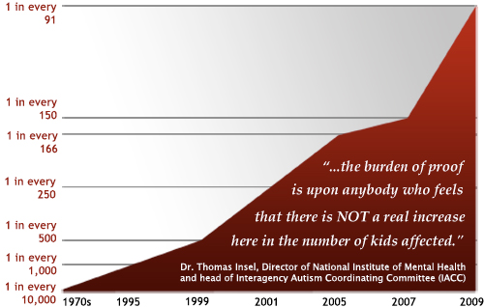
American Academy of Pediatrics Report, endorsed by
Centers for Disease Control and Prevention (CDC)

Slide 185
Oppositional Defiant Disorder
Pattern of negativistic, hostile, and defiant behavior lasting at least 6 mos during which 4 of the following are present
  1. often loses temper
  2. often argues with adults
  3. often actively defies or refuses to comply with adult requests
  4. often deliberately annoys people

Slide 186
Oppositional Defiant Disorder, Con’t
5. often blames others for his/her misbehavior
6. is often touchy and easily annoyed by others
7. is often angry and resentful
8. is often spiteful or vindictive
B. The disturbance in behavior causes clinically significant impairment in social, academic or occupational functioning

Slide 187
Conduct Disorder
Repetitive and persistent pattern of behavior in which the rights of others or societal norms are violated and manifested by 3 or more of the following criteria for 12 mos:
    - Aggression to people or animals
    - Destruction of property
    - Deceitfulness or theft
    - Serious violations of rules
B. Causes significant impairment in social, academic or occupational functioning
    Coded Mild, Moderate or Severe and age of onset

Slide 188
Conduct Disorder, Con’t
C.(Repetitive pattern of behavior in which the basic rights of others or societal norms are violated)
3 or more of the following in the last 3 mos:
- Aggression to people and animals
Bullies, threatens, intimidates, uses weapons, is cruel, forced sexual activity
- Destruction of property
Intentional acts of fire setting or destruction
- Deceitfulness or theft
Broken into a house, stolen a car, forgery, shoplifting

Slide 189
Attention Deficit/Hyperactivity Disorder
Either 1 or 2, present before age 7 and in 2 or more settings.
1. 6 or more of the following symptoms of inattention persisting at least 6 months:
Inattention
Failure to attend to details or making careless mistakes
Difficulty sustaining attention in tasks
Does not seem to listen when spoken to
Does not follow through on instructions
Has difficulty organizing tasks
Avoids tasks requiring sustained mental effort
Often loses things
Easily distracted
Forgetful in daily activities

Slide 190
Attention Deficit/Hyperactivity Disorder
2. 6 or more of the following symptoms of hyperactivity-impulsiveness
Hyperactivity
Fidgets with hands and feet
Leaves seat assigned in class
Runs about and climbs on things in inappropriate situations
Difficulty engaging in quiet activities
Talks excessively
Impulsivity
Often blurts out answers
Has difficulty waiting turn
Interrupts others

Slide 191
Personality Disorder List
Cluster A Cluster C
Paranoid Avoidant
Schizoid Dependent
Schizotypal Obsessive -
Cluster B Compulsive
Antisocial
Borderline
Histrionic
Narcissistic

Slide 192
Criteria for Personality Disorder
Enduring pattern of inner experience and behavior that deviates markedly from expectations of the culture. It is manifested on 2 or more of the following:
1. Cognition
2. Affectivity
3. Interpersonal functioning
4. Impulse control

Slide 193
Criteria for Personality Disorder, Con’t
5. Inflexible and pervasive pattern across social and personal situations
6. Pattern leads to clinically significant distress or impairment
7. Stable and of long duration
8. Onset in adolescence or young childhood.

Slide 194
Avoidant Personality Disorder
Pervasive pattern of social inhibition, feelings of inadequacy, and hyper-
sensitivity to negative evaluation
Indicated by 4 or more of the following:

Slide 195
APD con’t
Avoids occupational activities that involve significant interpersonal contact, fears criticism, disapproval or rejection;
Unwilling to get involved with people unless certain of being liked;
Shows restraint of intimate relationship for fear of being shamed and ridiculed;
Preoccupied with being criticized or rejected in social situations;

Slide 196
APD….continued
5. Is inhibited in new interpersonal situations because of feelings of inadequacy;
6. Views self as socially inept, personally unappealing, or inferior to others;
7. Is usually reluctant to take personal risks or to engage in any new activities.
Video Sample
http://www.youtube.com/watch?feature=player_detailpage&v=vIsg2V0mf6Y
http://www.youtube.com/watch?feature=player_detailpage&v=KmmZ2D13hHE

Slide 197
Paranoid Personality
Pervasive distrust and suspiciousness of others: their motives are interpreted as malevolent
Indicated by four or more of the following:
Suspects others are exploiting, harming or deceiving
Preoccupied with unjustified doubts about the loyalty or trustworthiness of others
Reluctant to confide in others because of unwarranted fear that the information will be used maliciously against him/her

Slide 198
Paranoid Personality, Con’t
4. Reads hidden meanings or threatening meanings in benign remarks or events
5. Persistently bears grudges, i.e., is unforgiving to insults, injuries, or slights
6. Perceives attacks on his/her character or reputation that are not apparent to others and is quick to react angrily or counterattack
7. Recurrent suspicions, without justification, regarding fidelity of spouse or partner
Movie: Conspiracy Theory (Mel Gibson) http://www.youtube.com/watch?feature=player_detailpage&v=dbRoVcULGBI

Slide 199
Antisocial Personality Disorder
A pervasive pattern of disregard for and violation of the rights of others occurring since age 15, indicated by 3 or more of the following:
1. Failure to conform to social norms with respect to lawful behaviors as indicated by repeatedly performing acts that are grounds for arrest;
At least 18 yrs. Old

Slide 200
Antisocial Personality Disorder Con’t
2.Deceitfulness, e.g., repeatedly lying, use of aliases, or conning others for personal profit or pleasure;
3. Impulsivity or failure to plan ahead;
4. Irritability and aggressiveness as in repeated physical fights or assaults;
5. Reckless disregard for safety of self or others;

Slide 201
Antisocial Personality Disorder Con’t
6. Consistent irresponsibility, as indicted in repeated failure to sustain consistent work behavior or honor financial obligations;
7. Lack of remorse, as in being indifferent to or rationalizing having
hurt, mistreated or stolen from another.

Slide 202
Antisocial Personality Disorder Con’t
B.
Evidence of Conduct Disorder with onset before age 15
Occurrence of antisocial behavior is not exclusively during course of a Manic episode or Schizophrenia
Video Description
http://www.youtube.com/watch?v=NfHo-HJObU8&feature=player_detailpage
Video Sample
http://www.youtube.com/watch?v=0qyCR9tPDgM&feature=player_detailpage

Slide 203
Narcissistic Personality Disorders
Pervasive pattern of grandiosity, need for admiration, and lack of empathy, beginning by early adulthood and present in a variety of contexts, as indicated by 5 of the following:
1. A grandiose sense of self-importance
2. Preoccupied with fantasies of unlimited success, power, brilliance, beauty or ideal love
3. Believes he/she is special and unique and can only be understood by or should associate with other special high-status people

Slide 204
Narcissistic Personality Disorders, Con’t
4. Requires excessive admiration
5. A sense of entitlement, i.e., unreasonable expectations of especially favorable treatment or automatic compliance with his/her expectations
6. Interpersonally exploitative, i.e., takes advantage of others to achieve his/her own needs
7. lacks empathy, is unwilling to recognize or identify with the feelings and needs of others
8. Often envious of others
9. Shows arrogant, haughty behaviors or attitudes
Video Sample: Manson
http://www.youtube.com/watch?v=f9jRDHGabp8&feature=player_detailpage

Slide 205
Obsessive-Compulsive
Pervasive pattern of preoccupation with orderliness, perfectionism, and mental and interpersonal control, at the expense of flexibility, openness, and efficiency
Indicated by at least 4 of the following:
1. Is preoccupied with details, rules, lists, order, organization, or schedules
2. Shows perfectionism that interferes with task completion
3. Is excessively devoted to work and productivity to the exclusion of leisure activities and friendships
4. Is over conscientious, scrupulous, and inflexible about matter of morality, ethic, or values

Slide 206
Obsessive-Compulsive, Con’t
5. Is unable to discard worn-out or worthless objects even when they have no sentimental value
6. Is reluctant to delegate tasks or to work with others unless they submit to exactly his/her way of doing things
7. Adopts a miserly spending style toward both self and others: money is hoarded for catastrophes
8. Shows rigidity and stubbornness
Video Sample
http://www.youtube.com/watch?feature=player_detailpage&v=gcaKjEdYRBw

Slide 207
Borderline Personality Disorder
Pervasive pattern of instability of interpersonal relationships, self-image, and affects, and marked impulsivity beginning by early childhood and present in a variety of contexts, as indicated by 5 or more of the following:
1. Frantic efforts to avoid real or imagined abandonment

Slide 208
Borderline Personality Disorder, Con’t
2. A pattern of unstable and intense interpersonal relationships characterized by alternating between extremes of idealization and devaluation
3. Identity disturbance: markedly and persistently unstable self-image or sense of self
4. Impulsivity in at least two areas that are potentially self-damaging

Slide 209
Borderline Personality Disorder, Con’t
5. Recurrent suicidal behavior, gestures, or threats, or self-mutilating behavior
6. Affective instability due to marked reactivity of mood
7. Chronic feelings of emptiness
8. Inappropriate, intense anger or difficulty controlling anger
9. Transient, stress related paranoid ideation or severe
http://www.youtube.com/watch?v=eOphgCJX1FY
http://www.youtube.com/watch?v=bIzphW-VbGQ&feature=player_detailpage

Slide 210
Histrionic Personality Disorder
Pervasive pattern of excessive emotionality and attention seeking, beginning by early childhood and present in a variety of contexts, as indicated by 5 or more of the following:
1. Uncomfortable in situations which he/she is not the center of attention
2. Interaction with others is often characterized by inappropriate sexually seductive or provocative behavior

Slide 211
Histrionic Personality Disorder, Con’t
3. Displays rapidly shifting and shallow expression of emotion
4. Constantly uses physical appearance to draw attention to self
5. Has a style of speech that is excessively impressionistic and lacking in detail
6. Shows self-dramatization, theatricality, and exaggerated expression of emotion
7. Is suggestible, easily influenced by others and circumstances
8. Considers relationships to be more intimate than they actually are
http://www.youtube.com/watch?v=PugKA4546VE http://www.youtube.com/watch?v=_UvZxSp3UGI&feature=player_detailpage

Slide 212
Dependent Personality
Pervasive and excessive need to be taken care of that leads to submissive and clinging behavior and fears of separation
Indicated by at least 5 of the following:
1. Difficulty making everyday decisions without an excessive amount of advice and reassurance
2. Need others to assume responsibility for most major areas of his/her life
3. Has difficulty expressing disagreement with others because of fear of loss of support or approval

Slide 213
Dependent Personality, Con’t
4. Has difficulty initiating projects or doing things on his/her own
5. Goes to excessive lengths to obtain nurturance and support from others
6. Feels uncomfortable or helpless when alone because of exaggerated fears of being unable to care for himself or herself
7. Urgently seeks another relationship as a source of care and support when a close relationship ends
8. Is unrealistically preoccupied with fears of being left to take care of himself or herself
http://www.youtube.com/watch?v=hO6kaMiUrOg

Slide 214
Hypochrondriasis
Preoccupation with fears of having a serious disease based on misinterpretation of bodily symptoms which has a duration of at least 6 months.

Slide 215
Hypochrondriasis
The preoccupation:
a. Persists despite appropriate medical evaluation and reassurance
b. Is not of a delusional intensity or restricted to appearance
c. Causes clinically significant distress or impairment in functioning
d. Is not better accounted for by other anxiety disorders or major depression

Slide 216
Pain Disorder
Pain in 1 or more anatomical sites of sufficient severity to warrant clinical attention
Pain causes clinically significant distress or impairment in social, occupational, or other important areas of functioning
Psychological factors are judged to have an important role in the onset severity exacerbates or maintenance of the pain
The symptom is not intentionally produced
The pain is no better accounted for by Mood, Anxiety, or Psychotic Disorder

Slide 217
Pain Disorder (cont.)
Examples of impairment include:
  Inability to work or attend school
  Frequent use of the healthcare system
  The pain becomes a major focus in the individual’s life
  Substantial use of medications
  Relationship problems such as marital discord
  Disruption of the family’s normal lifestyle

Slide 218
Malingering
Intentional production of false or grossly exaggerated physical or psychological symptoms
Motivation is of external incentive
  Avoiding work, school, or military duty
  Obtaining financial compensation
  Evading criminal prosecution
  Obtaining drugs

Slide 219
Malingering continued
According to the DSM-IV – TR:
Healthcare professionals should suspect malingering in any of the following combination of circumstances;
  Medicolegal context of presentation
  Marked discrepancy between the persons claim to stress or disability and the objective findings
  Lack of cooperation during the diagnostic evaluation and in complying with the prescribed treatment regimen
  The presence of antisocial personality disorder

Slide 220
Malingering continued
Clinical differentiation:
  Intentional production of symptoms
  Prolonged recovery time
  Unexplained exacerbation
  Symptom relief is not obtained during the time frame suggested and discussed in the doctor-patient relationship during the report of findings.
  Any positive tests for malingering

Slide 221
Professional Therapy
Psychology
Social work
Psychiatry
  All the above degrees have the option of obtaining a bachelor’s, master’s, and doctorate in their respective fields.

Slide 222
Psychology
The American Psychological Association (APA)
Education-
  Bachelors –(BS) four years in an accredited program
    Primarily research methods
    Masters - (MS) four years undergraduate and two or four years in a graduate program
    Ph.D. -two-year programs usually with a special emphasis on choosing a specialization, internship, and providing therapy
    Licensure: Psychologists in independent practice any type of patient care—including clinical, counseling, and school psychologists
      Vary from state to state

Slide 223
Psychology continued
Licensure-
  Usually require a Ph.D. and one to two years of experience
  Limit scope of practice to professional competence
  The completion of an approved internship
  examination

Slide 224
Psychiatry
Medical doctor (MD or DO)
  Medical school degree
  For year residency
  Prescribe medication
  Some provide psychotherapy-though it may be limited to pharmaceutical management

Slide 225
Social Work
bachelor's degree- usually in social work (BSW). Other majors, such as psychology or sociology.
    Four years in an accredited program
    Masters-(MSW) undergraduate degree plus two years in accredited program
    Internship(six months or a year)
    Doctorate-(DSW) educator in university or research

Slide 226
Social Work continued
Licensure-
  All states and the District of Columbia require social workers to be either licensed, certified or registered
Advancement for Social Workers: MSW/DSW
With related work experience and an advanced degree, a social worker may move up to a position as supervisor, program manager, assistant director, or executive director of a social service agency or department.

Slide 227
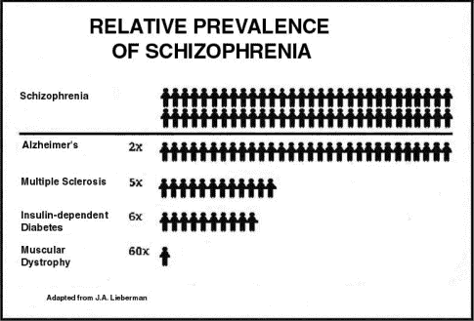
Prevalence of Schizophrenia Compared to Other Well-Known Diseases

Slide 228
Schizophrenia…...............Relative Prevalence cont’d..
Therefore, the approximate number of people in the United States suffering from:
  Schizophrenia: Over 2.2 million people
  Multiple Sclerosis: 400,000 people
  Insulin-dependent Diabetes: 350,000 people
  Muscular Dystrophy: 35,000 people

Slide 229
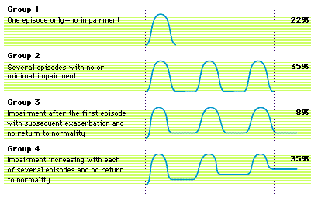
Categorizing by Severity

Slide 230
Prognosis
After 10 years, of the people diagnosed with schizophrenia:
  25% Completely Recover
  25% Much Improved, relatively independent
  25% Improved, but require extensive support network
  15% Hospitalized, unimproved
  10% Dead (Mostly Suicide)

Slide 231
Terminology Clarification
Positive symptoms: Hearing voices, suspiciousness, feeling under constant surveillance, delusions, or making up words without a meaning (neologisms).
Negative (or deficit) symptoms: Social withdrawal, difficulty in expressing emotions (in extreme cases called blunted affect), difficulty in taking care of themselves, inability to feel pleasure. (These symptoms cause severe impairment and are often mistaken for laziness.)
Cognitive symptoms: Difficulties attending to and processing of information, in understanding the environment, and in remembering simple tasks.
Affective (or mood) symptoms: Most notably depression, accounting for a very high rate of attempted suicide in people suffering from schizophrenia.

Slide 232
Schizophrenia
Characteristic symptoms:
2 or more of the following present during 1 month:
positive symptoms:
delusions
hallucinations
disorganized speech
grossly disorganized or catatonic behavior

Slide 233
Schizophrenia Con’t
negative symptoms
affective flattening
alogia
avolition
Anhedonia
B. Social/occupational dysfunction
C. Duration for at least 6 months
D. R/O schizoaffective, substance abuse or medical condition http://www.youtube.com/watch?v=bWaFqw8XnpA
http://www.youtube.com/watch?feature=player_detailpage&v=vo79NDNumlo

Slide 234
Typical (First Generation) Antipsychotic Medication
mg/day
Chlorpromazine(Thorazine) 300-100
Fluphenazine(Prolixin) 5-20
Mesoridazine(Serentil) 150-400
Perphenazine(Trilafon) 16-64
Thioridazine(Mellaril) 300-800
Trifluoperazine(Stelazine) 15-50
Haloperidol(Haldol) 5-20

Slide 235
Atypical (Second Generation) Antipsychotic Medication
mg/day
Aripiprazole(Abilify) 10-30
Clozapine(Clozaril) 150-600
Olanzapine (Zyprexa) 10-30
Quetiapine(Seroquel) 300-800
Risperidone(Risperdal) 2-8
Ziprasidone(Geodon) 120-200

Slide 236
Major Side Effects of Antipsychotic Medications
Sedation
Autonomic Effects
Endocrine Effects
Skin and Eye Complications
Neurological Effects
- Dystonia
- Pseudo parkinsonism
- Akinesia
- Akathisia

Slide 237
Major Side Effects of Antipsychotic Medications, Cont.
Tardive Dyskinesia
Neuroleptic Malignant Syndrome
Agranulocytosis
Seizures
Sudden Death

Slide 238
ELDERLY
Dementias (Alzheimers Type)
Anxiety Disorders
Mood Disorders (Depression/Bipolar)
Psychotic Disorders (Schizophrenia/Medical condition)

Slide 239
ALZHEIMERS (Dementia)
A. The development of multiple cognitive deficits manifested by both:
1.Memory impairment (impaired ability to learn new information or to recall previously learned information)
2.One or more of the following cognitive disturbances:
(a) aphasia (language disturbance)
(b) apraxia (impaired ability to carry out motor activities depite intact motor function)
(c) agnosia (failure to recognize or identify objects despite intact sensory function)
(d) disturbance in executive functioning (i.e., planning, organizing, sequencing, abstracting)

Slide 240
ALZHEIMERS (Dementia)
B. The cognitive deficits in criteria A1 and A2 each cause significant impairment in social or occupational functioning and represent a significant decline from a previous level of functioning.
C. The course is characterized by gradual onset and continuing cognitive decline.
D. The cognitive deficits in Criteria A1 and A2 are not due to any of the following:
(1) other central nervous system conditions that cause progressive deficits in memory and cognition (e.g., cerebrovascular disease, Parkinson's disease, Huntington's disease, subdural hematoma, normal-pressure hydrocephalus, brain tumor)

Slide 241
ALZHEIMERS (Dementia)
(2) systemic conditions that are known to cause dementia (e.g., hypothyroidism, vitamin B or folic acid deficiency, niacin deficiency, hypercalcemia, neurosyphilis, HIV infection)
(3) substance-induced conditions
E. The deficits do not occur exclusively during the course of a delirium

Slide 242
Anxiety Disorders (Elderly)
Panic disorder with or without agoraphobia: The main characteristic of panic disorder is the occurrence of a panic attack linked with the fear of another attack. Agoraphobia is not, within a clinical setting, categorised as a disorder but is usually associated in some way with panic disorder. Agoraphobics are afraid of places or situations in which they may have another attack and be unable to leave or find someone to help them.

Slide 243
Anxiety Disorders (Elderly)
Phobias: Specific phobias and social phobia are both included under this heading. A phobia is described as an intense and irrational fear of a specific object or situation that is so intense it can cause the individual to be compelled to go to great lengths to avoid it. Phobias can be about harmful things or situations that present a risk but they can also be of harmless situations, objects or sometimes animals. Social phobia can include a fear of being judged, scrutinised or humiliated in some way. It can show itself with a fear doing certain things in front of others such as public speaking or using the toilet.

Slide 244
Anxiety Disorders (Elderly)
Obsessive Compulsive Disorder is characterised by unwanted, intrusive, persistent or repetitive behaviours. These will reflect a person’s attempts to control them and the anxiety caused by them. OCD effects around 2-3% of the population making it far more common than it was previously considered to be.
Stress disorders: This includes post traumatic stress disorder (PTSD) and acute stress disorders. These are categorised as being a symptomatic response to a traumatic experience that the individual has had.

Slide 245
Anxiety Disorders (Elderly)
Generalised Anxiety Disorder (GAD) is the most commonly diagnosed anxiety disorder and usually affects young adults.
Anxiety disorders due to known physical cause: This includes medical conditions and symptoms caused by drug misuse.
Anxiety disorder not otherwise specified: This is not a separate type of disorder but included in order to cover symptoms that do not meet the criteria for any of the other anxiety disorders.

Slide 246
Somatization
Definition
the conversion of mental experiences or states into bodily symptoms

Slide 247
Somatization Disorder
A history of many physical complaints beginning before age 30 years.
Occurs over a period of several years
Results in treatment being sought or significant impairment in social, occupational, or other important areas of functioning.
Each of the following criteria must be met:

Slide 248
Somatization Disorder Con’t
a. four pain symptoms
b. two gastrointestinal symptoms
c. one sexual symptom
d. one pseudo-neurological symptom
e. either
(1) symptoms cannot be explained by a known general medical condition
(2) if a general medical condition, the physical complaints or impairment are in excess

Slide 249
Conversion Disorder
One or more symptoms or deficits affecting voluntary motor or sensory functions that suggest a neurological or other general medical condition.
Psychological factors are judged to be associated with the symptom or deficit because the initiation or exacerbation of the symptom or deficit is preceded by conflicts or other stressors.

Slide 250
Conversion Disorder, Con’t
3. The symptom or deficit;
a. Is not intentionally produced or feigned
b. Is not explained by a general medical condition or a substance
c. Causes clinically significant distress or impairment in functioning or warrants medical evaluation
d. Is not limited to pain or sexual dysfunction occurring during Somatization Disorder or the result of another medical condition

Slide 251
http://www.youtube.com/watch?v=lSSAyCL3kuo&feature=player_detailpage

